Slide 1
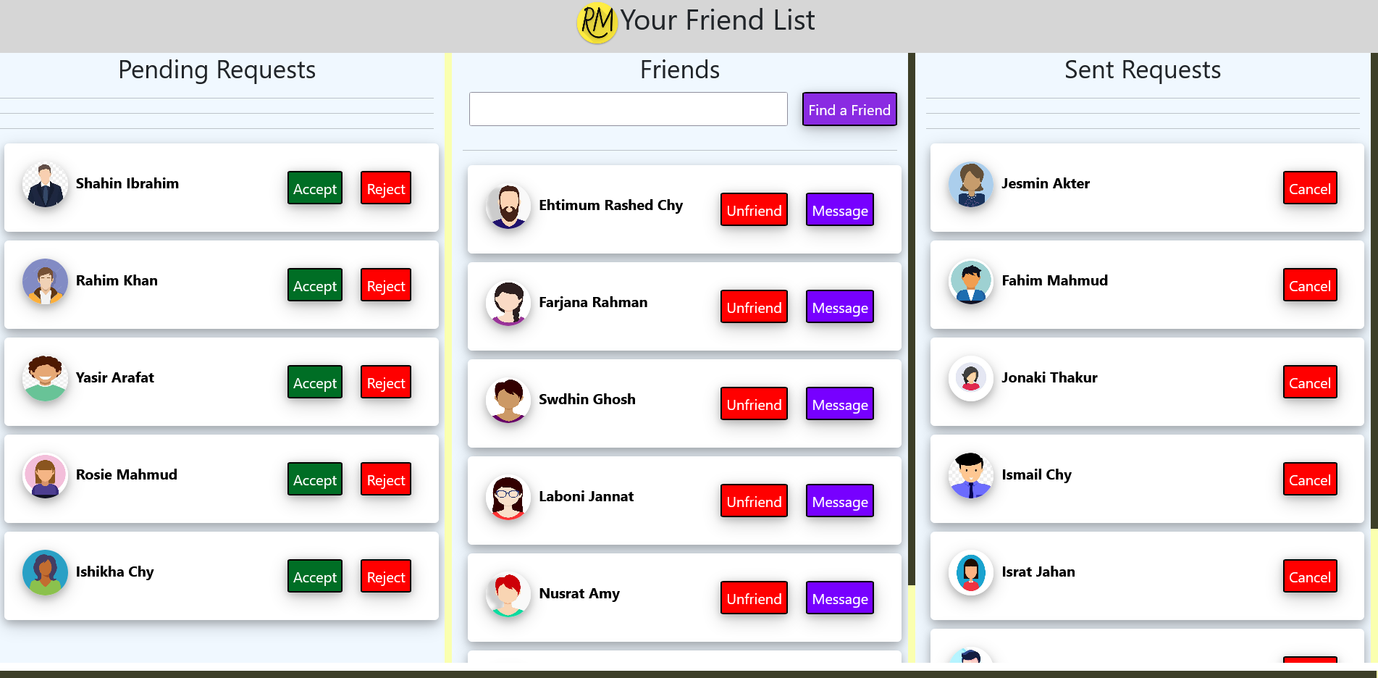
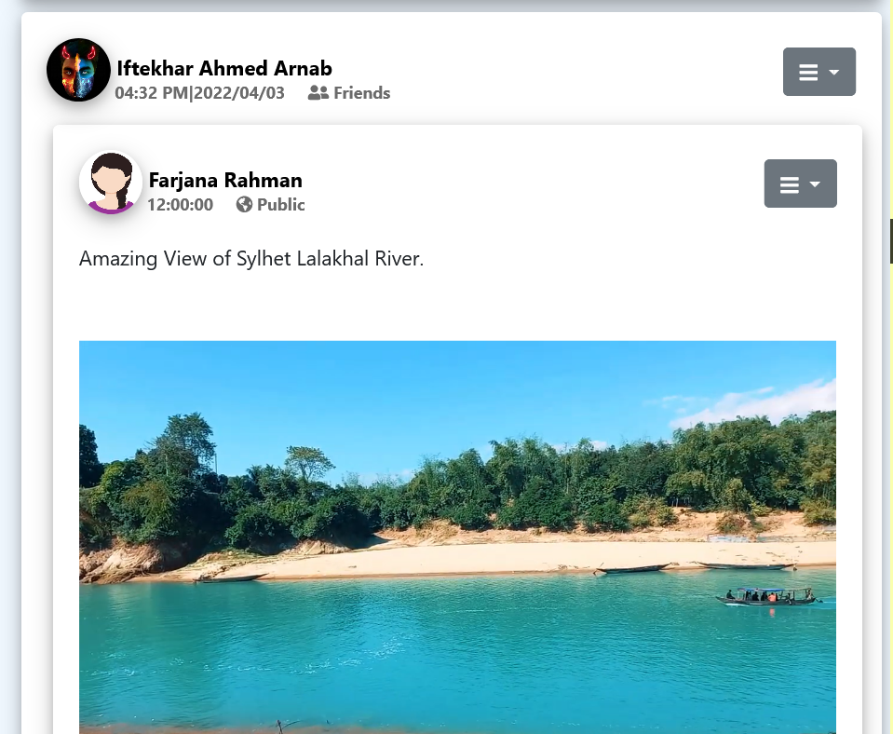
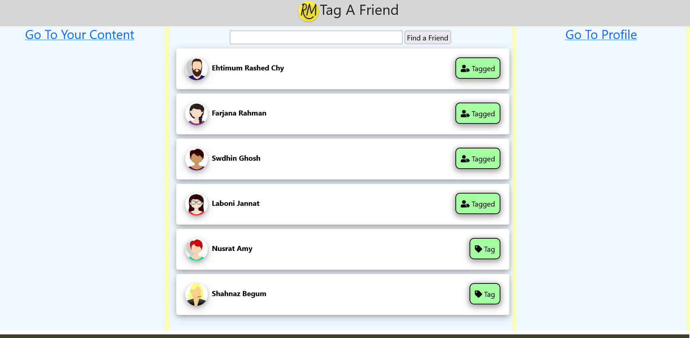
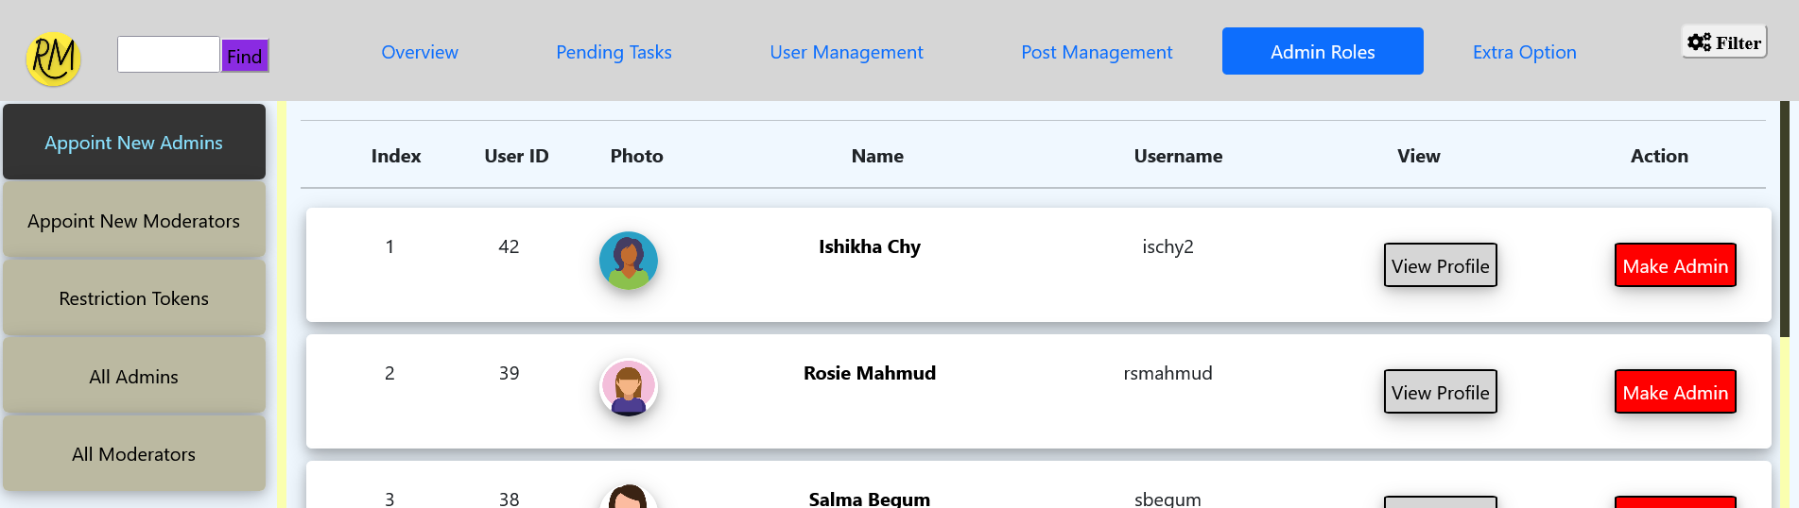
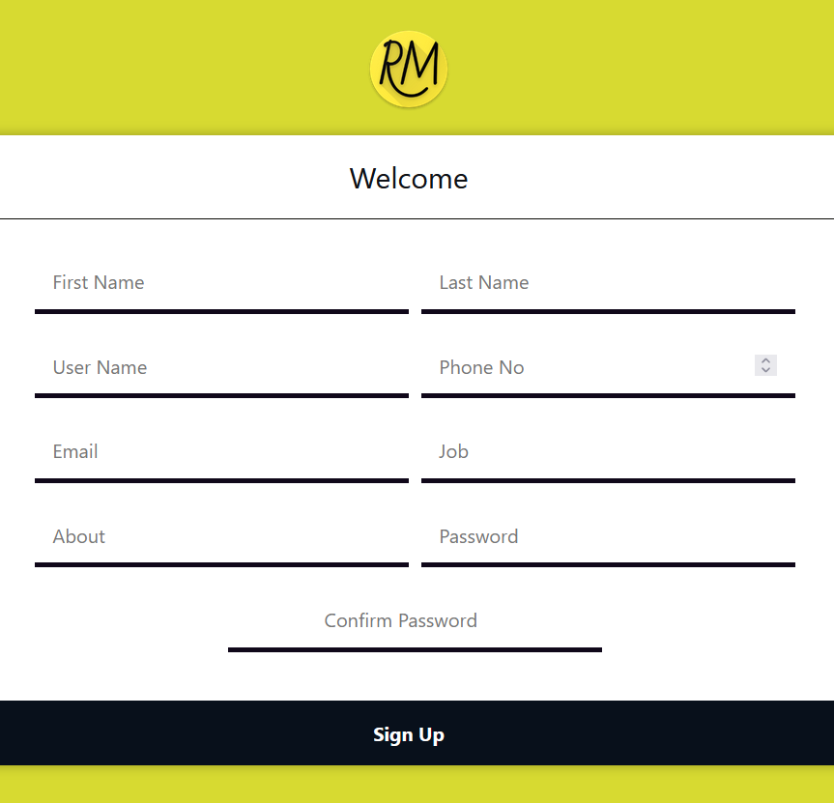
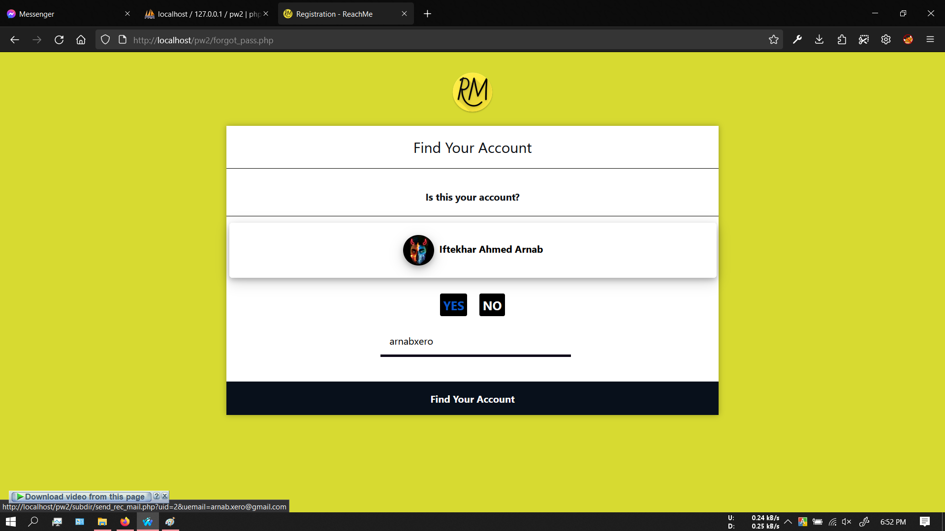
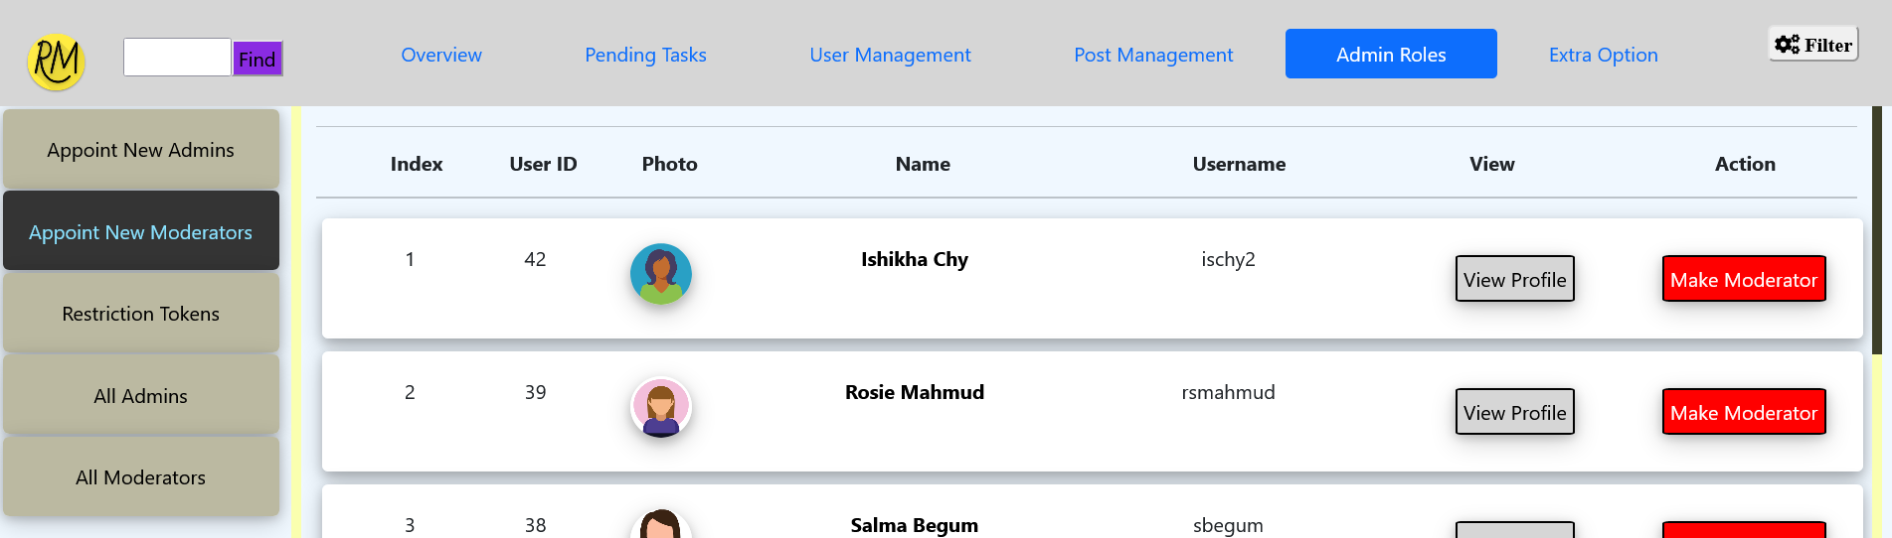
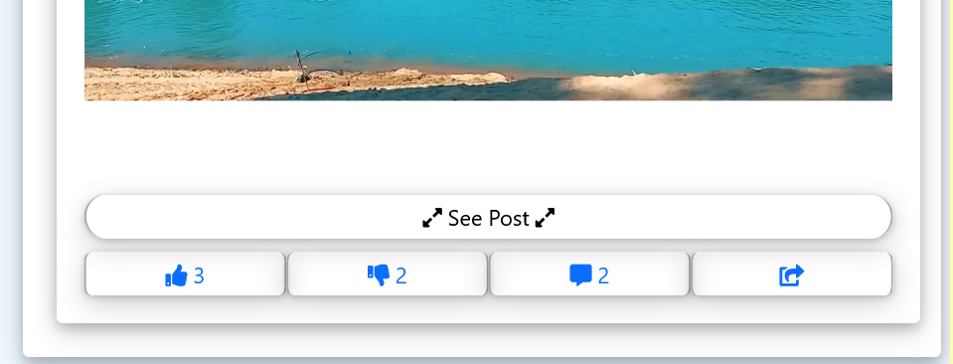
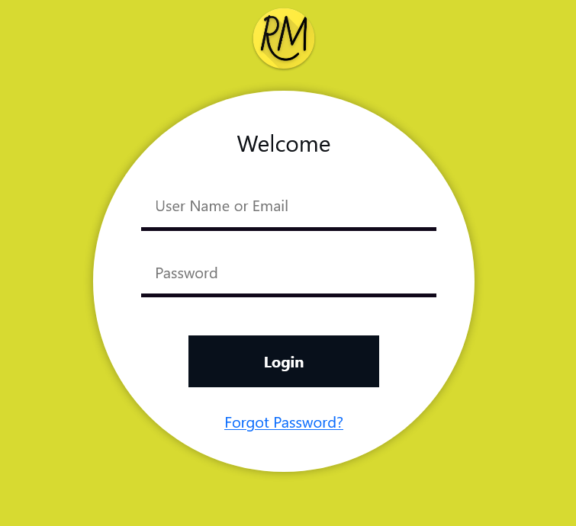
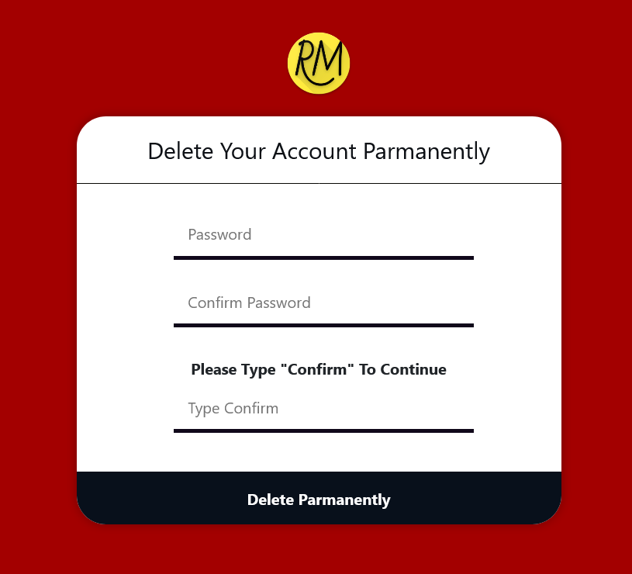
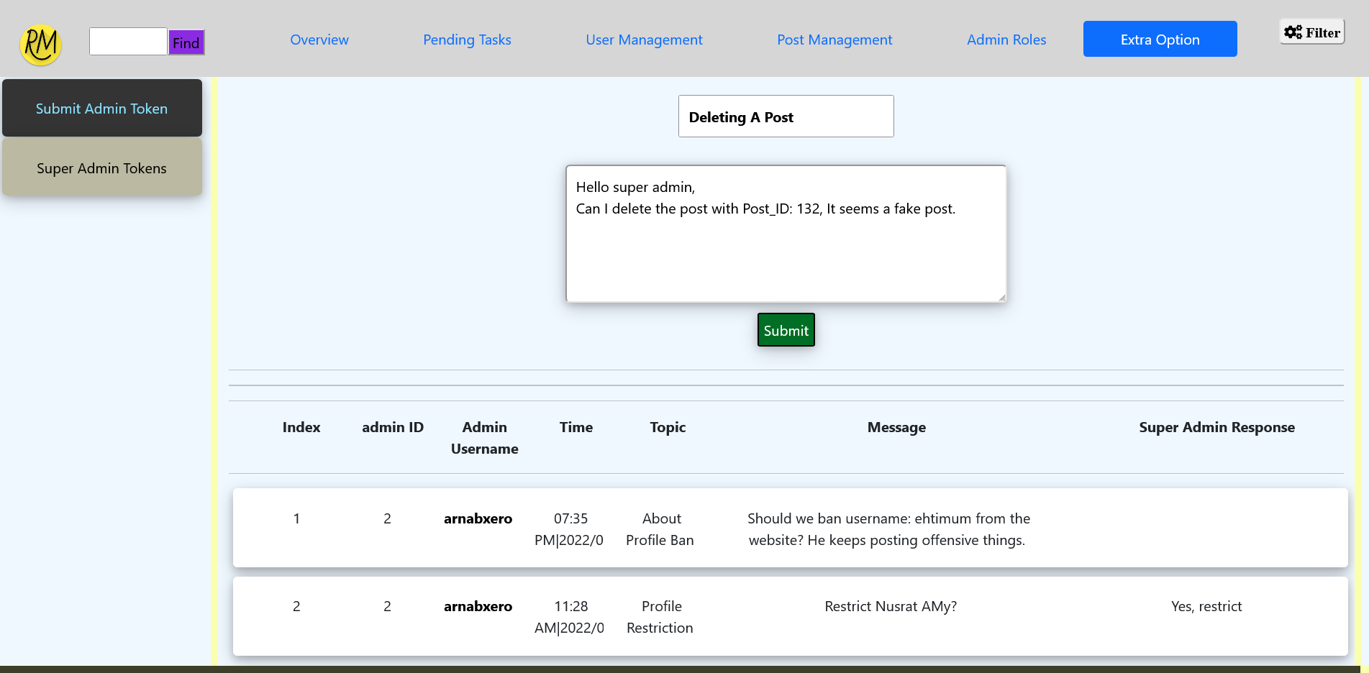
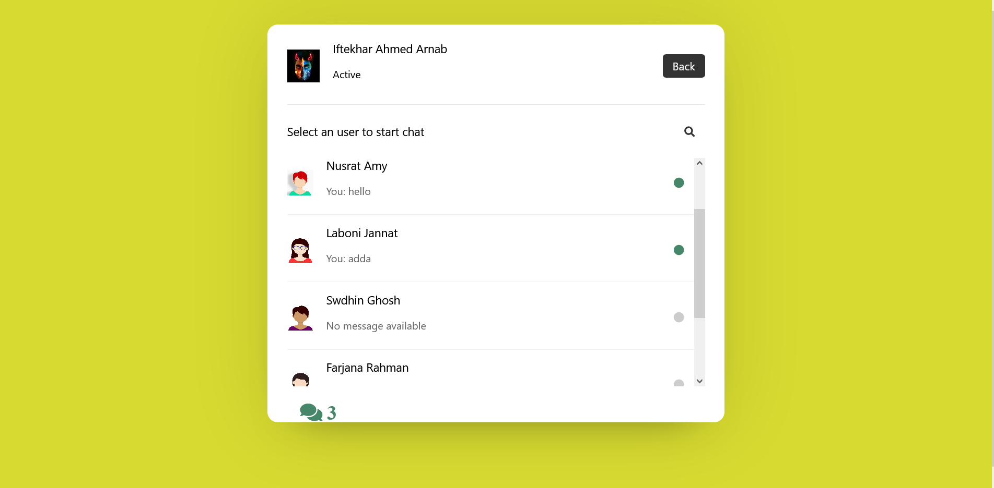
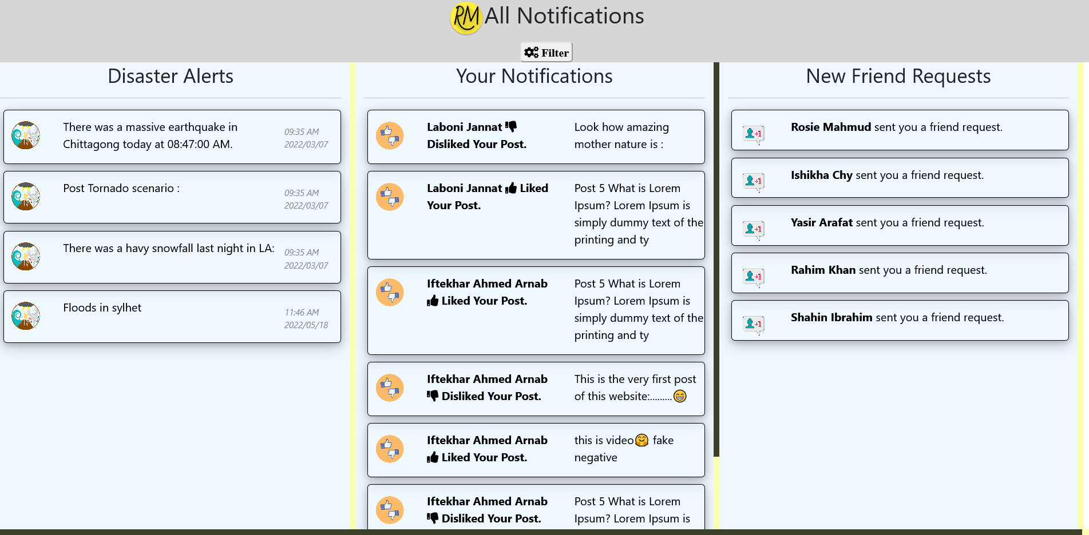
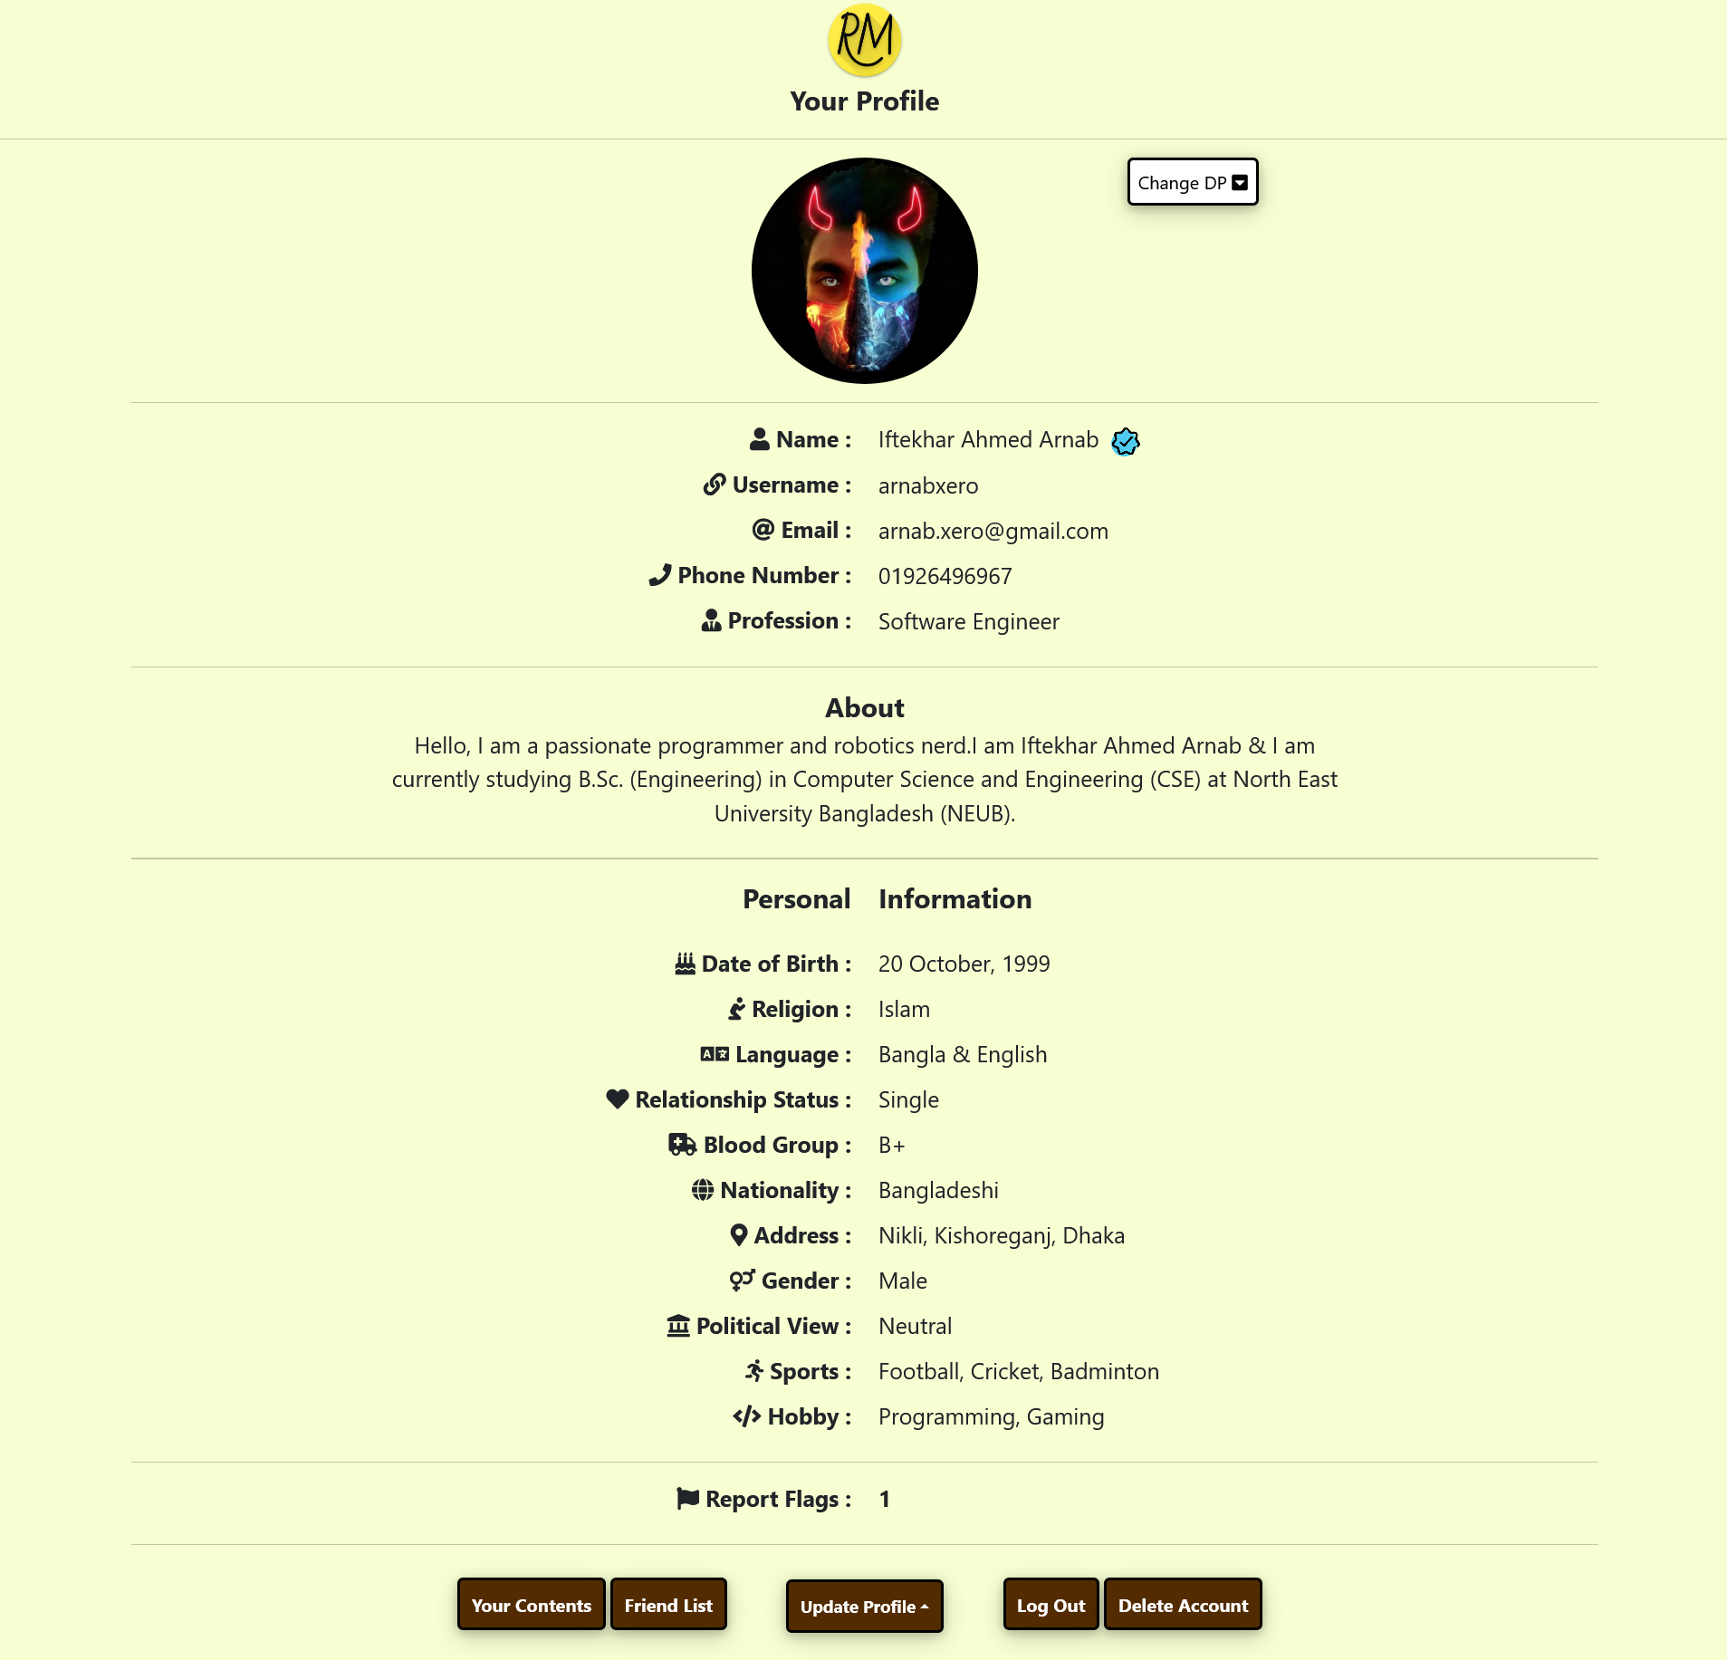
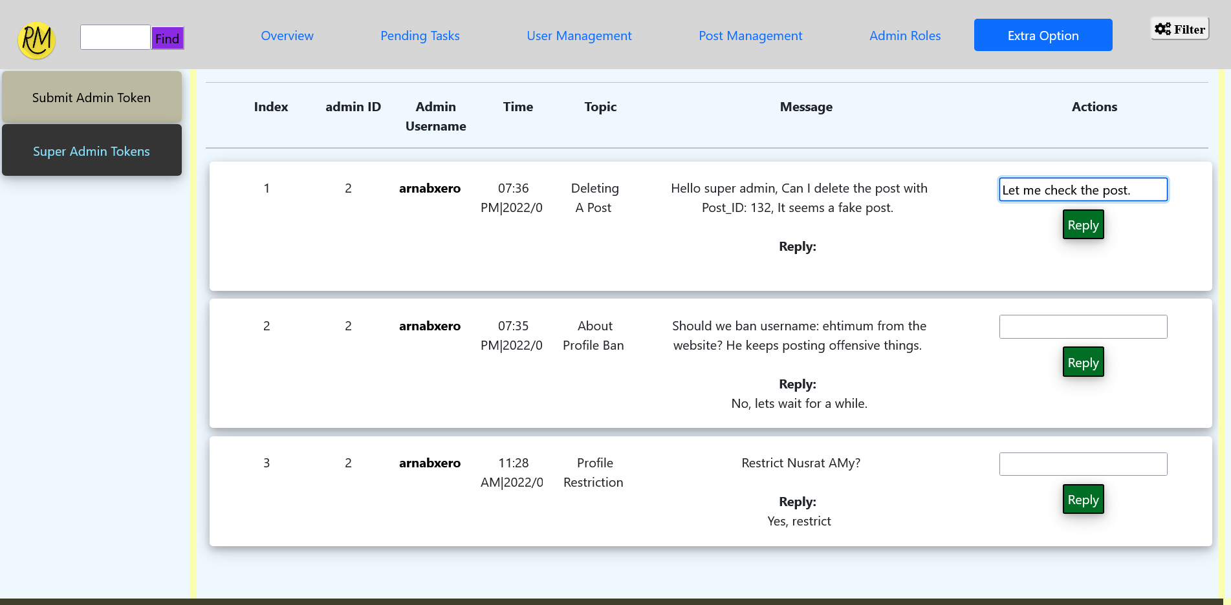
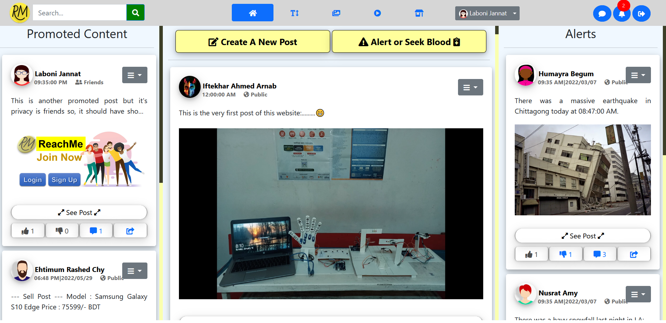
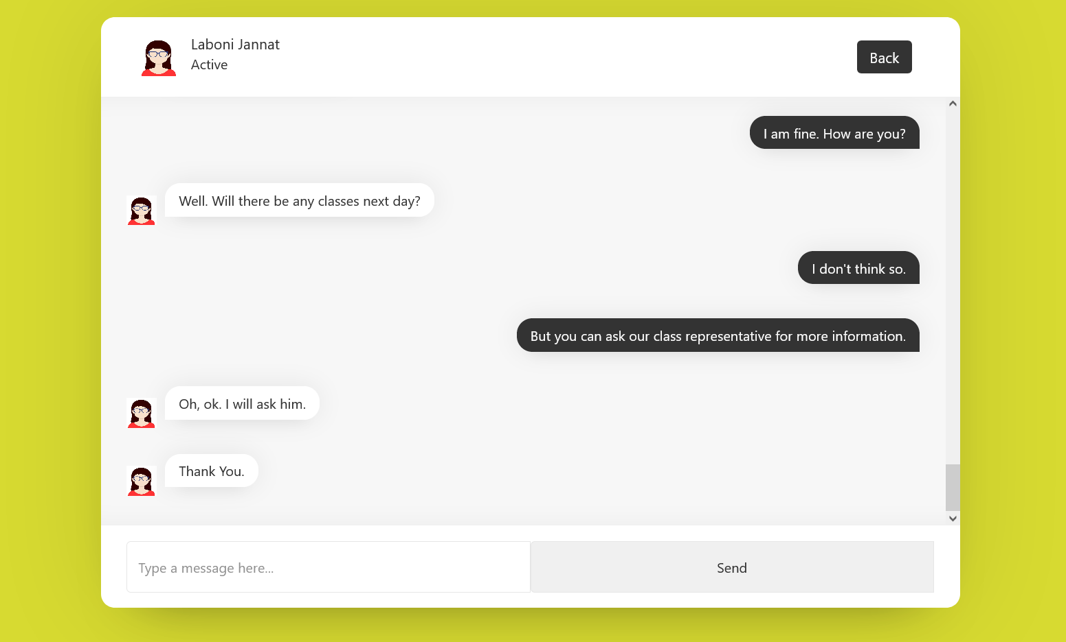
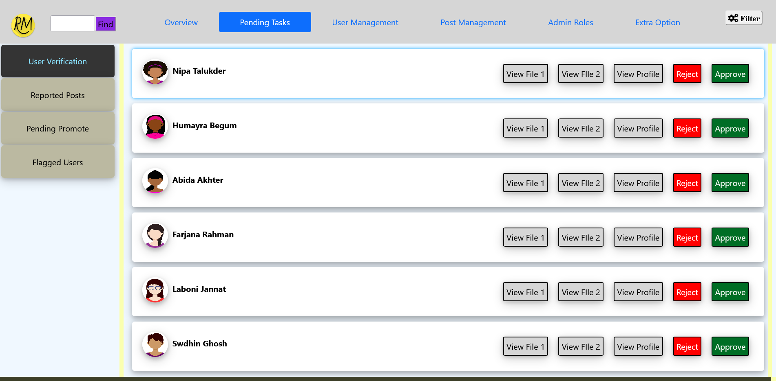
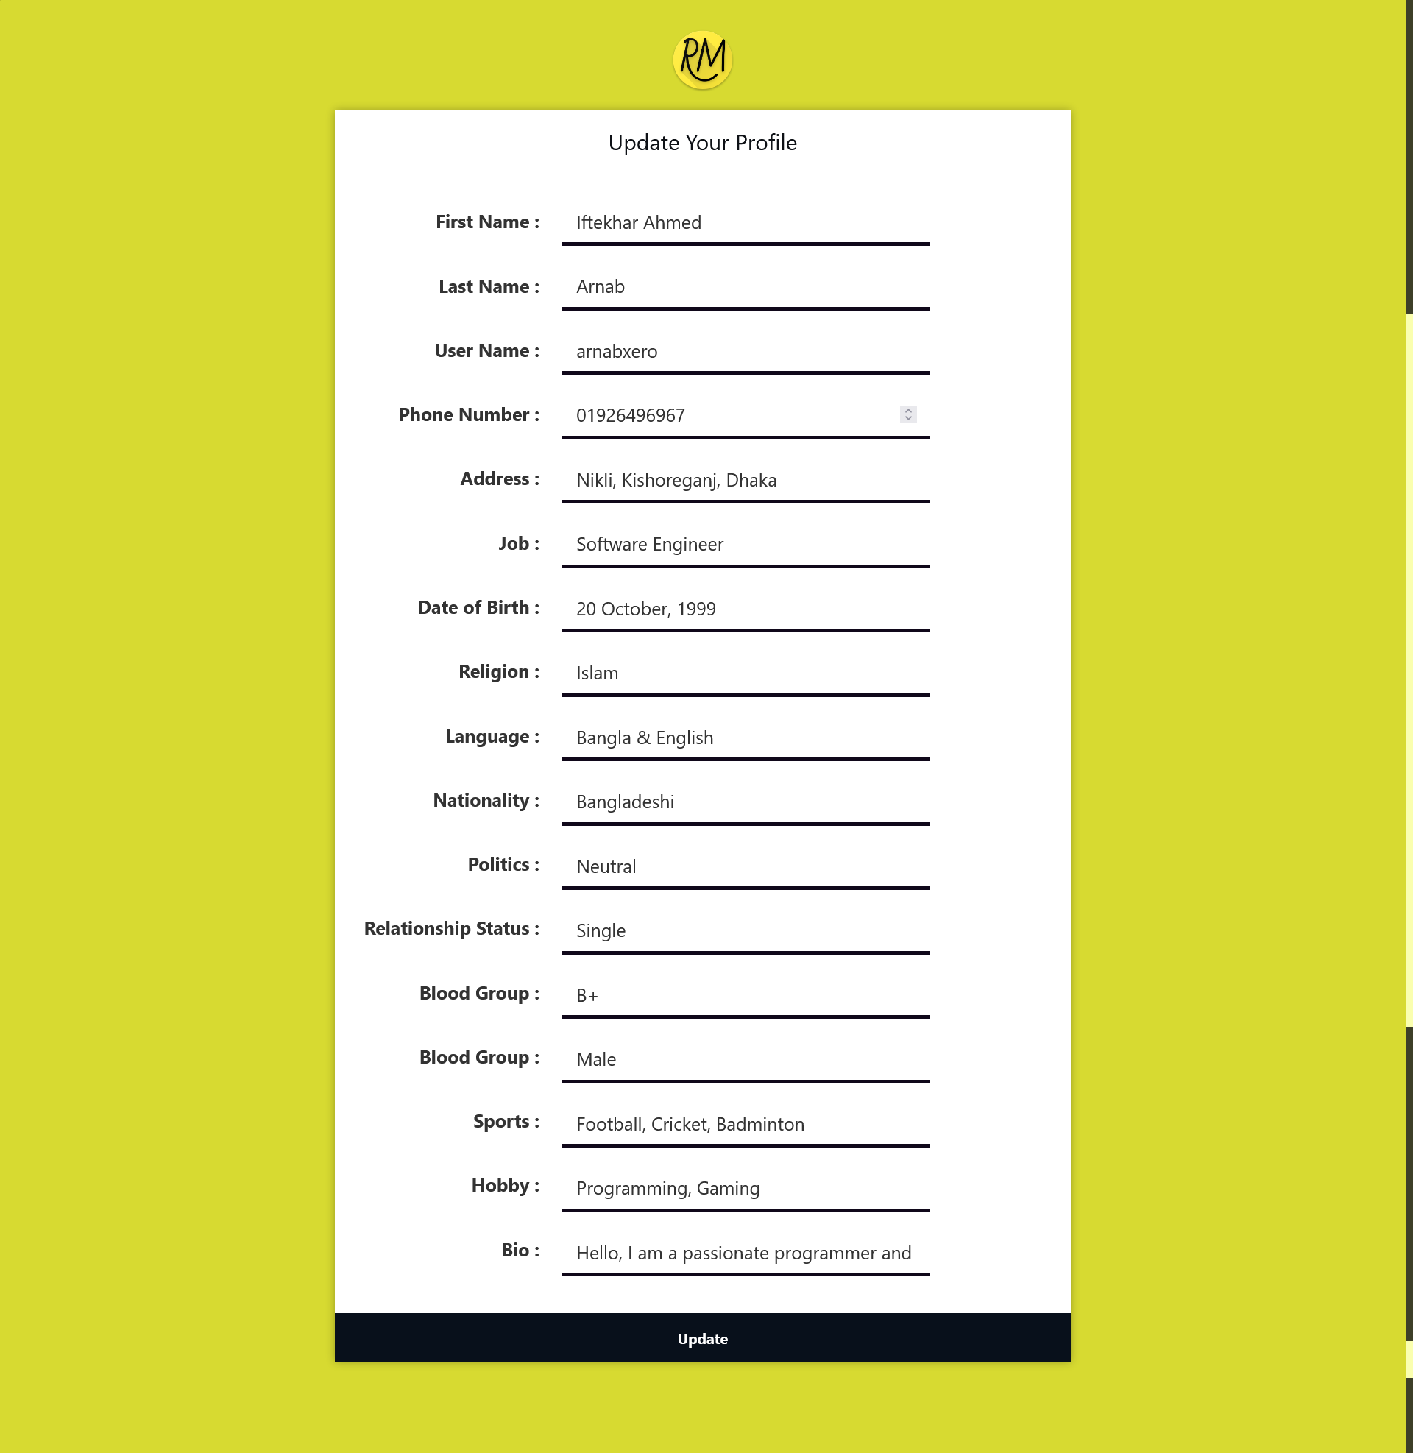
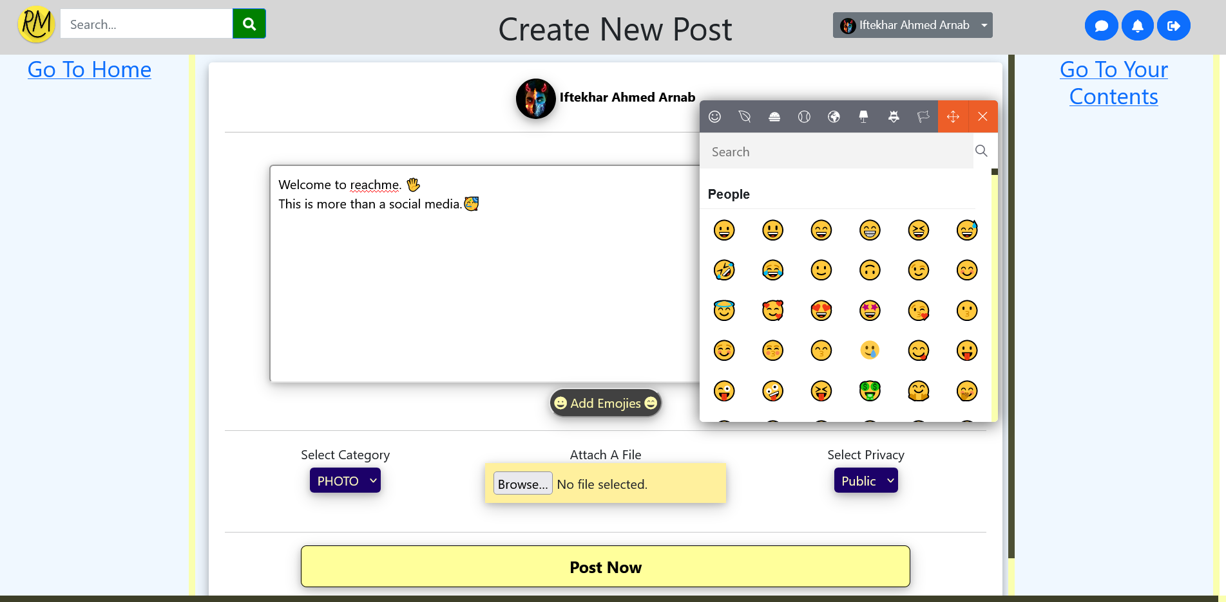
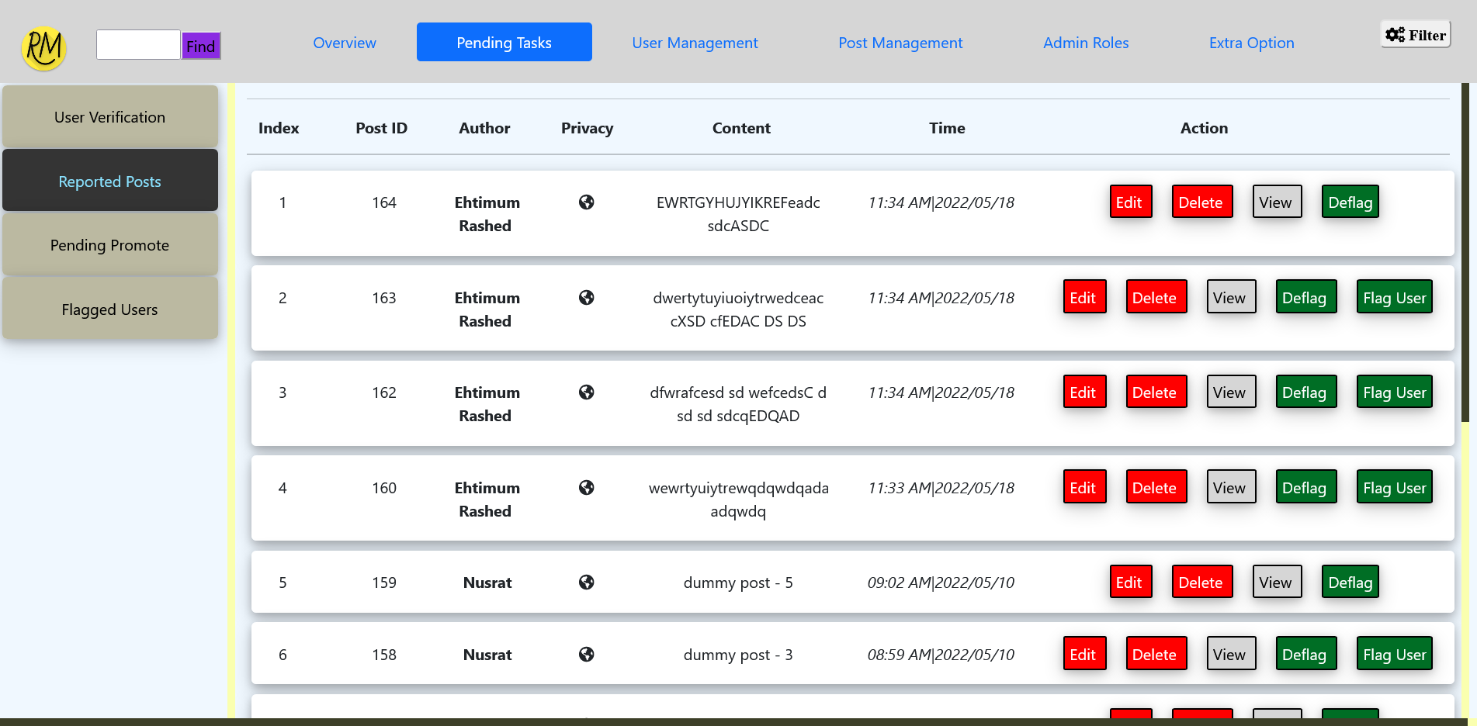
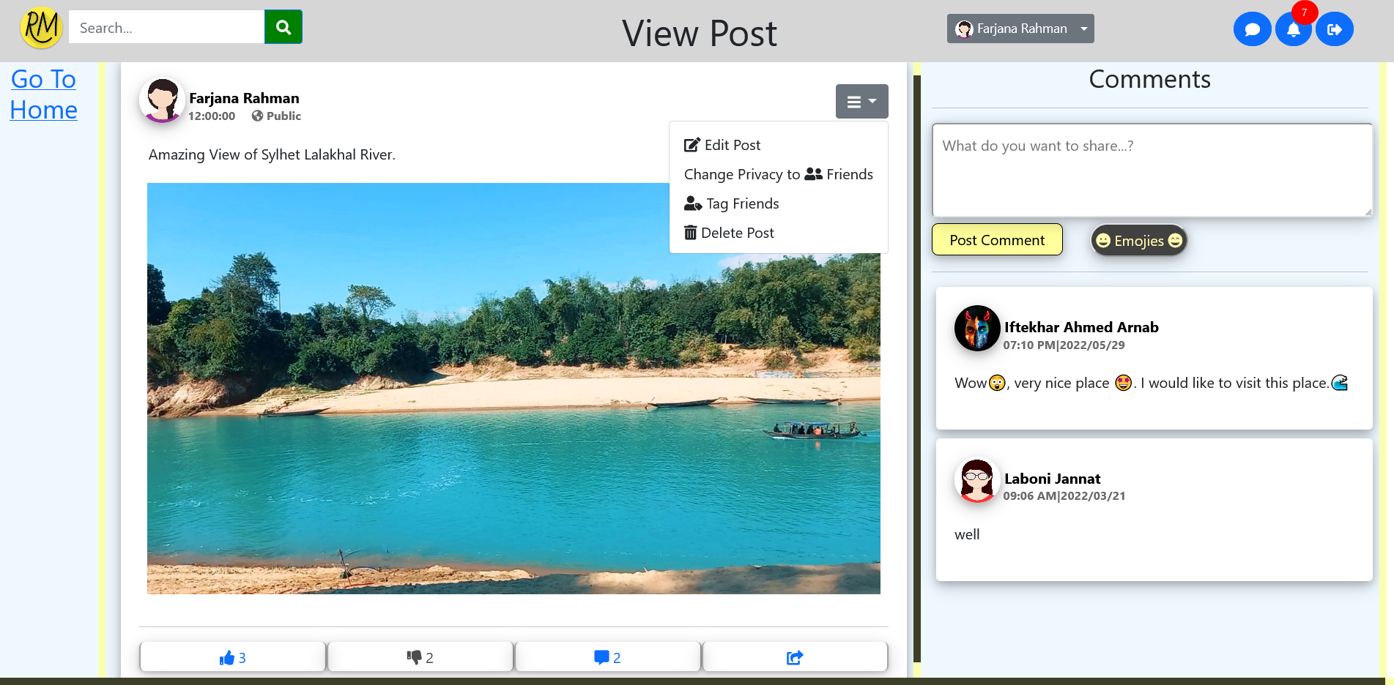
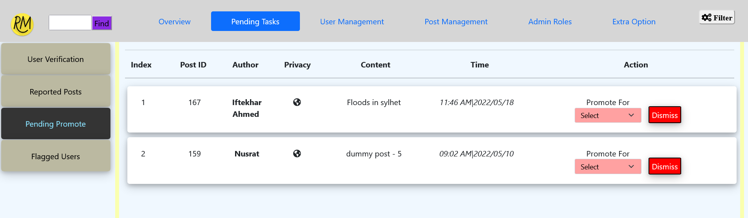
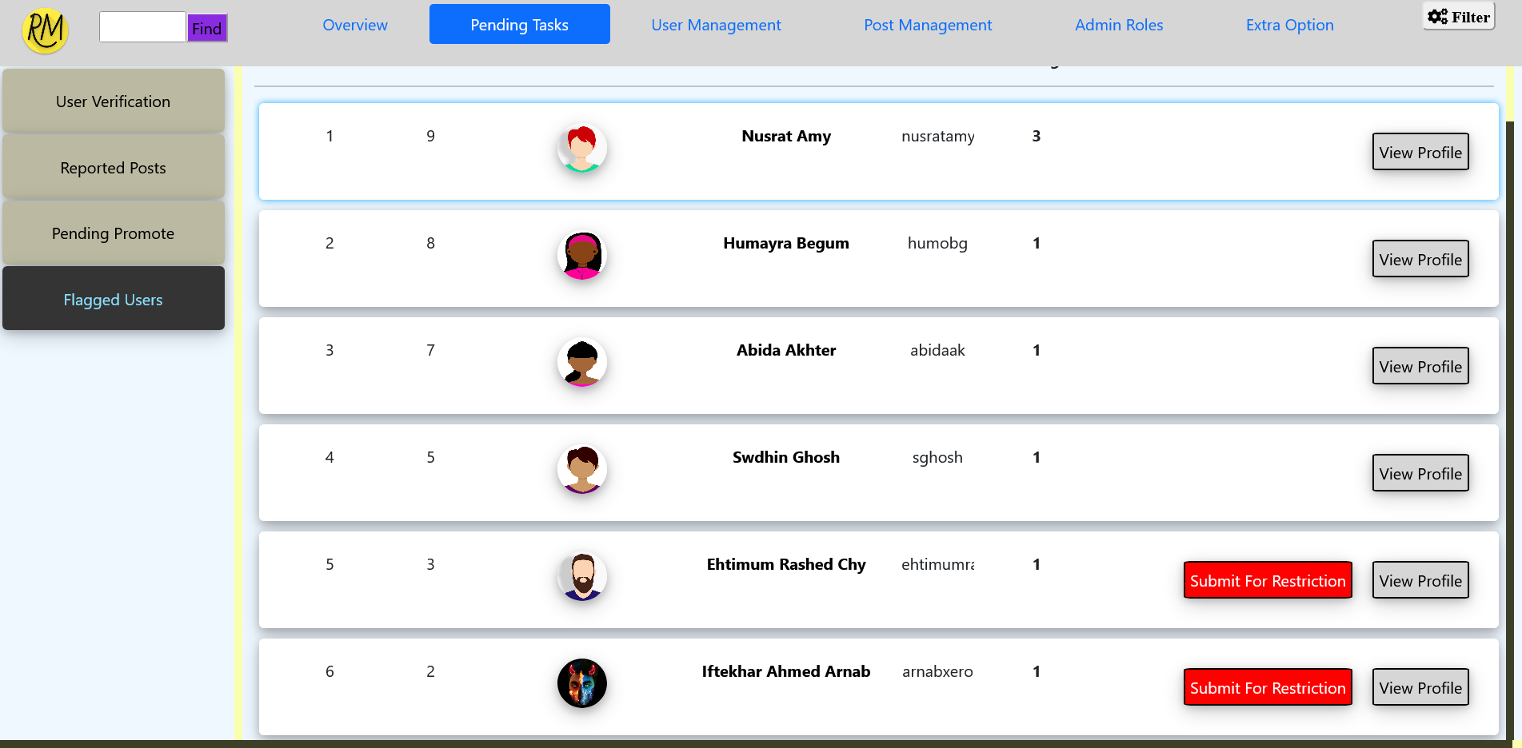
ReachMe – More Than A Social Media (For CSE – 300 at 01/06/2022)
Eftakhar Ahmed Arnob – 190103020028, Ehtimam Rashed Chowdhury – 190103020026, Farzana Rahman – 190203020101
Major Features:
Basic CRUD functionality.
A very rich & secured login, registration, account recovery & disabling system.
User profile has various details such as name, username, email, phone, bio, address & many personal information.
Secured profile email or password update system via verification code.
Friend list system similar to Facebook where user can send, receive or accept friend requests.
Simple yet secured chat system, where user can also see other active users in the friend list.
Post create system similar to Facebook where photo, video with or without text can be posted on user’s timeline. Posts can also be edited or deleted by user.
Like, dislike, comment, share and tagging system for posts along with secured privacy option. Also users can report a post if it goes against community standards.
A delicate notification panel to view latest notifications on various activities such as new message, friend request, likes, comments, post tagging etc.
A searching system with keywords by which user content or profiles can be found.
A homepage with header menu consisting of content category filtering, user menu, chat, notification and search bar. The homepage features promotional, personalized and alert type contents.
The site moderation tools on admin panel are user verification approval, reported content moderation, post promote, flagging users, user post modification via approval from a automated word scanning system.
The admin panel also consists of some other features as like appointing new admin by super admin, appointing new moderator by admins, secured internal communication system between super admin, admin and moderators.
Registration, Recover, Login, Disable Account Interface
Friend List Interface
Post Share and Tagging Interface
Admin Panel Tools
Chat List, Chat System Interface
Notification Panel Interface
Own Profile, Update Profile Interface
Homepage
Admin Panel Site Moderation Tools
Contribution:
Arnab initially planned the project and the database structure.
Arnab built the page design template.
Ehtimum built the login, registration and account recovery mechanism.
Ehtimum built the chat system & profile verification system.
Farjana
Post Create Interface
View Post and Interaction Interface
Tools and Technologies:
Standard HTML, CSS for front end.
JS, PHP for backend and dynamic features.
MySQL for database. MySQL event for timed MySQL commands.
JQuery for responsive chat system.
PHPMailer for verification code mailing system.

